Slide 2
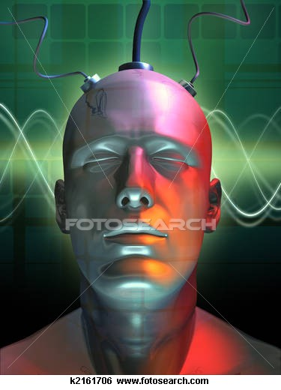
ARTIFICIAL INTELLIGENCE
PRESENTATION BY:
FUTURE IT &
PRESENTATION POINT

Slide 3
History By:

Slide 4
ARTIFICIAL INTELLIGENCE
What Do We Mean By Artificial Intelligence (A.I.)?
History of A.I.
Fields of A.I.
Use of A.I.

Slide 5
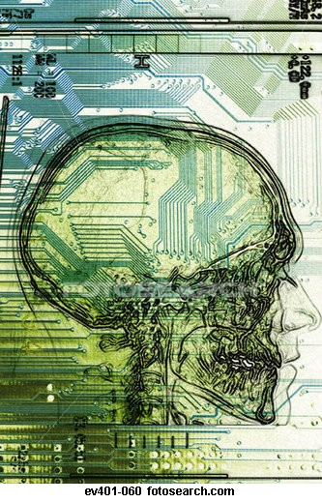
What is A.I ?
Definition:
“Artificial intelligence (AI) is a branch of computer science that deals with intelligent behavior, learning, and adaptation in machines”
( Wikipedia )

Slide 6
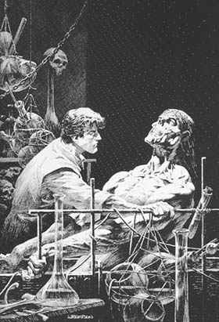
History of A.I ?
The original story, published by Mary Shelley, in 1818, describes the attempt of a true scientist, Victor Frankenstein,
to create life.

Slide 7
History of A.I ?
Joseph Faber's Amazing Talking Machine (1830-40's).
A speech synthesizer variously known as the Euphonia and the Amazing Talking Machine. By pumping air with the bellows ... and manipulating a series of plates, chambers, and other apparatus (including an artificial tongue ... ),
The operator could make it speak any
European language

Slide 8
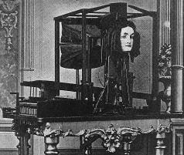
History of A.I ?
EUPHONIA
(THE TALKING MACHINE)

Slide 9
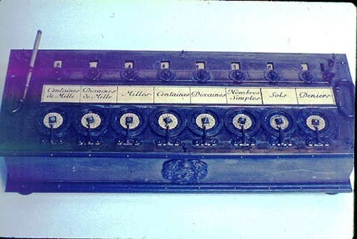
History of A.I ?
The Roots of Modern Technology
1642 Pascal built
an adding
machine
1694 Leibnitz reckoning machine

Slide 10
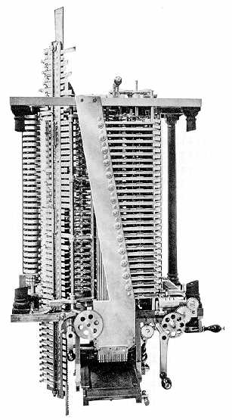
History of A.I ?
The Roots, continued
1834 Charles Babbage’s
Analytical Engine
Ada writes of the engine, “The Analytical Engine
can do whatever we
know how to order it
to perform.”

Slide 11
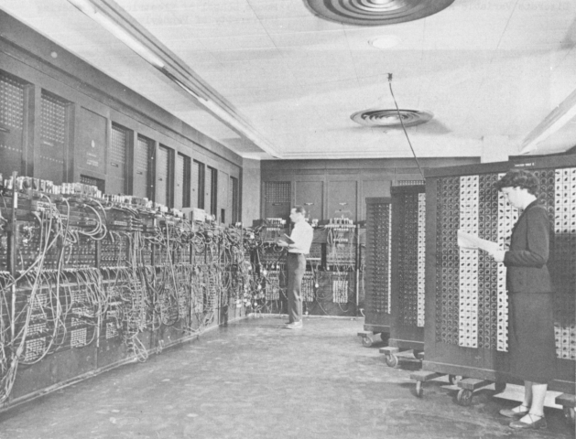
The Advent of the Computer
History of A.I ?
1945 ENIAC
“The first electronic digital computer”

Slide 12
Feilds Of A.I ?
Computer
Science
Linguistics
Artificial
Intelligence
Philosophy
Psychology
Mathematics
Biology

Slide 13
Practical Applications Of A.I ?
Handwriting Recognition
Expert Systems
Optical Character Recognition
Neural Networks
Machine Translation
Speech Recognition
Computer Algebra Systems
Machine Vision

Slide 14
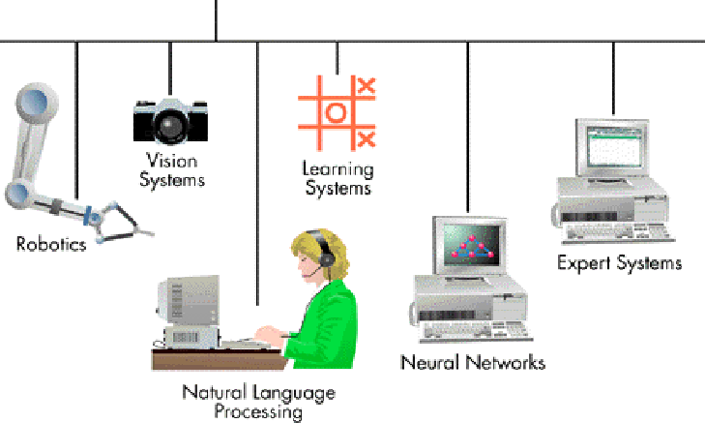
Practical Applications Of A.I ?
Artificial intelligence
Expert systems

Slide 15
ROBOTS BY:

Slide 16
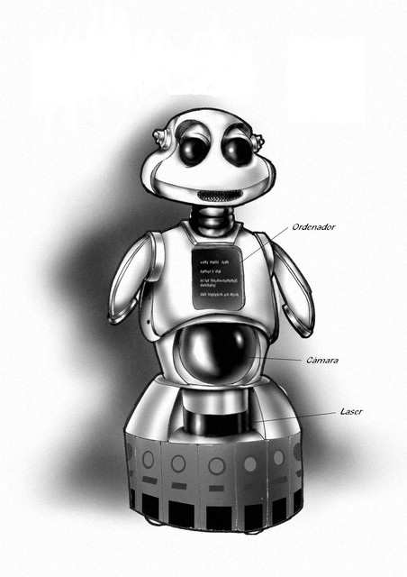
Introduction to ROBOTICS:
What does mean by ….ROBOTICS..
Definition of Robots
History of Robots

Slide 17
Introduction to ROBOTICS:
“Robotics” is the science and technology of Robots, their design, manufacture, and application.

Slide 18
Intro ROBOTS:
"A reprogrammable, multifunctional manipulator designed to move materials, parts, tools, or specialized devices through various programmed motions for the performance of a variety of tasks." .
(The Robot Institute Of America 1979)

Slide 19
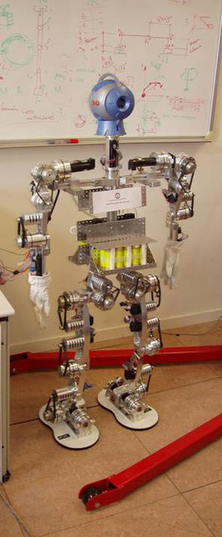
Applications of AI :
( ROBOTS )
Space Exploration
Healthcare
Domestic
Military defense
Manufacturing
Recreational/ Social Use
Agriculture
Other intelligent machines

Slide 20
Applications of AI :
( ROBOTS )
700,000 robots were in the industrial world in 1995 and over 500,000 were used in Japan. About 120,000 in Western Europe and 60,000 in the United States and many were doing tasks too dangerous or unpleasant for humans!!!!!

Slide 21
Applications of AI :
( ROBOTS )
Space Exploration
Two important devices exist which are proven space robots
Remotely Operated Vehicle (ROV)
Remote Manipulator System (RMS)

Slide 22
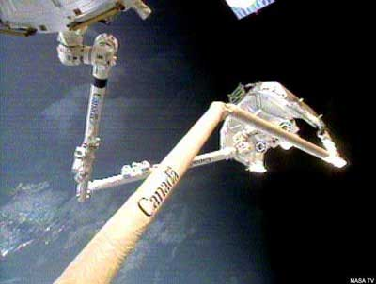
Applications of AI
(ROBOTS):
This picture shows a Historic Space Handshake between Shuttle and Space Station
(Robots - Image Courtesy of CSA)

Slide 23
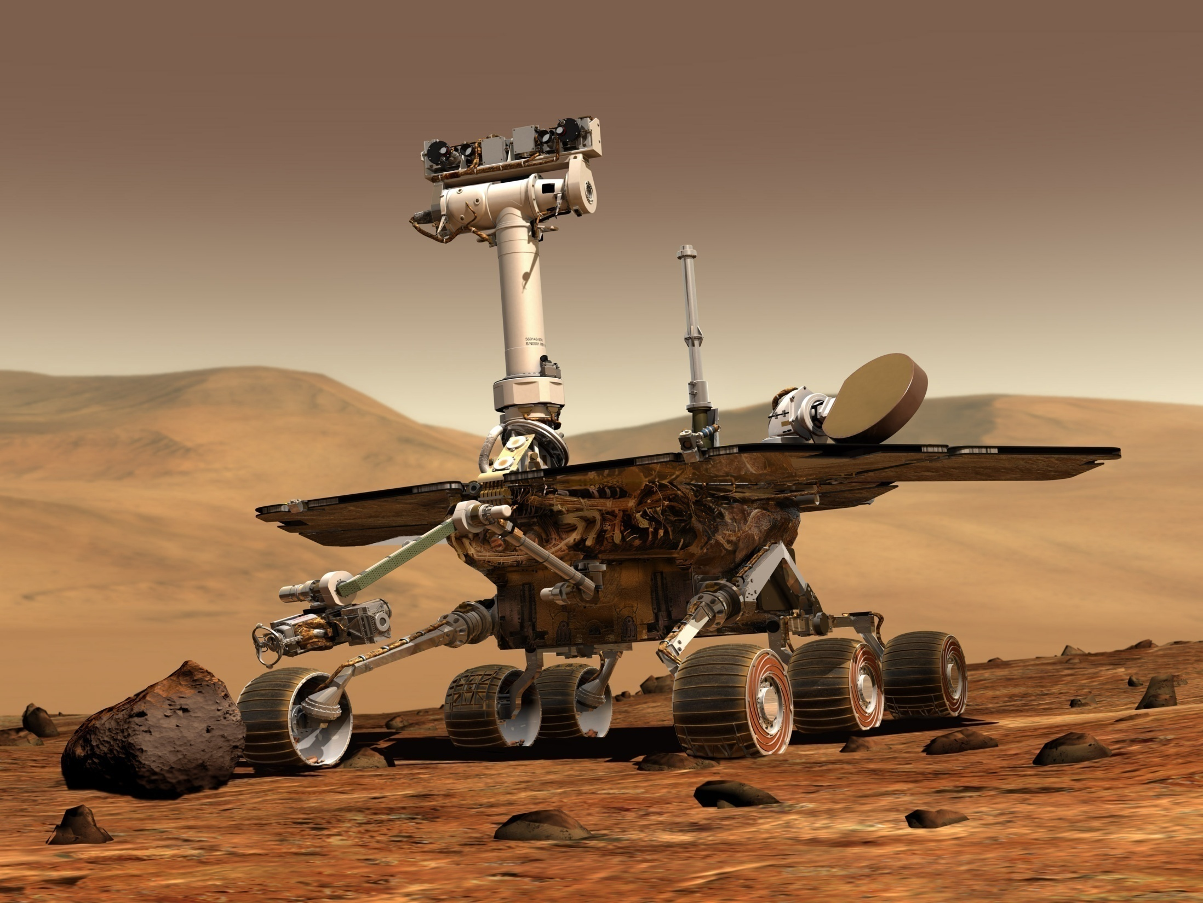

Slide 24
Applications of AI
(ROBOTS):
Healthcare Robots are used sometimes for operations. A human could never drill a hole exactly one 100th of a inch wide and long.
e.g.
Tug robot (delivery robot), RoboDoc
Robotic Wheelchair can facilitate patient locomotion

Slide 25
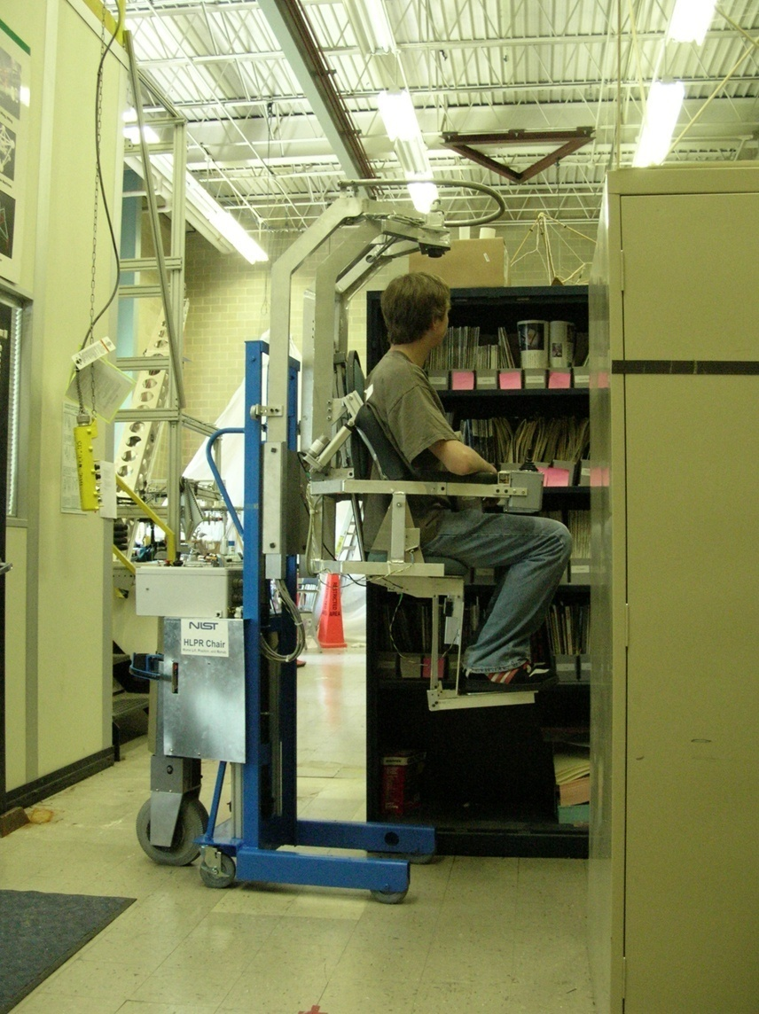
Applications of AI
(ROBOTS):

Slide 26
Other applications by:

Slide 27
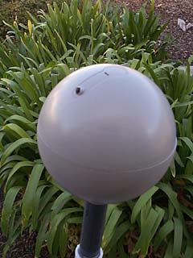
Applications of AI
(ROBOTS):
Domestic Use
These robots perform domestic chores and perform simple tasks like grass cutting, vacuum cleaning, plant watering, etc.
e.g. Scooba, Robomower

Slide 28
Applications of AI
(ROBOTS):
Military Defense
The U.S. military is currently using robots to diffuse bombs and to transport goods in danger zones. These vehicles (AGVs) use sensors and coordinates to guide themselves through streets and rough terrain to supply ammunition and food stuff to soldiers.
e.g. iRobot Packbot, Transbotics

Slide 29
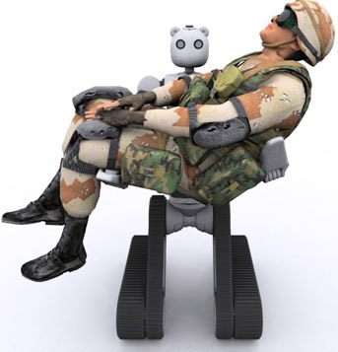
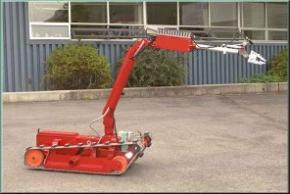
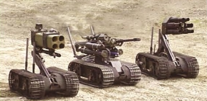
Applications of AI
(ROBOTS):

Slide 30
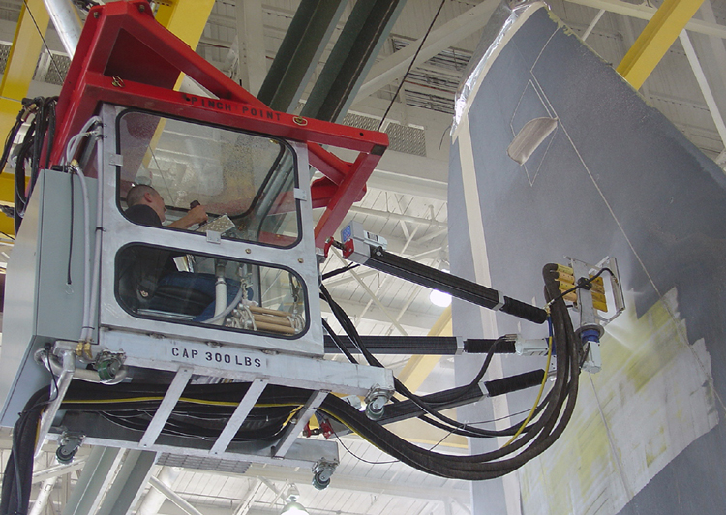
Applications of AI
(ROBOTS):
Manufacturing
Probably the industry which uses robots the most. Robots are useful in repetitive tasks and also work for longer durations without breaks.
e.g. Robots in car production assembly line

Slide 31
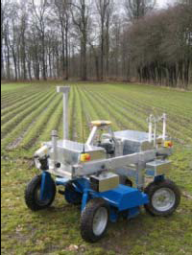
Applications of AI
(ROBOTS):
Agriculture
Robots can do the work that took a dozen harvesters to do at the same time.
Robots are used for harvesting, reaping and
sowing purposes.
They are sometimes
called,
‘Agrobots’.

Slide 32
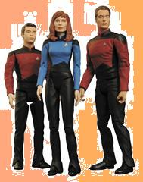
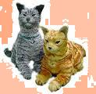
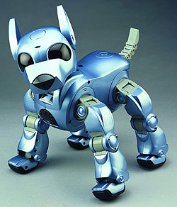
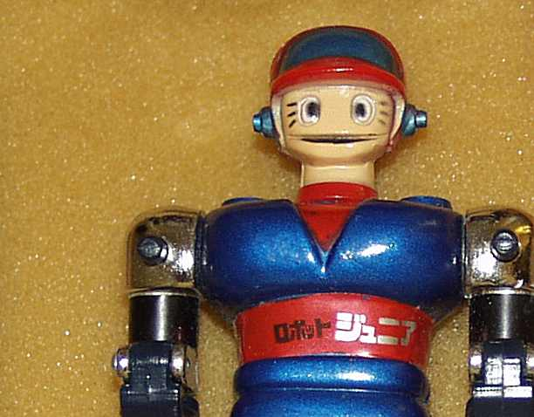
Applications of AI
(ROBOTS):
Recreational/ Social Use
These robots are built for purely recreational purposes. They provide company and are most life-like.
e.g. Asimo (the humanoid robot), Aibo (the widely popular robotic dog)

Slide 33
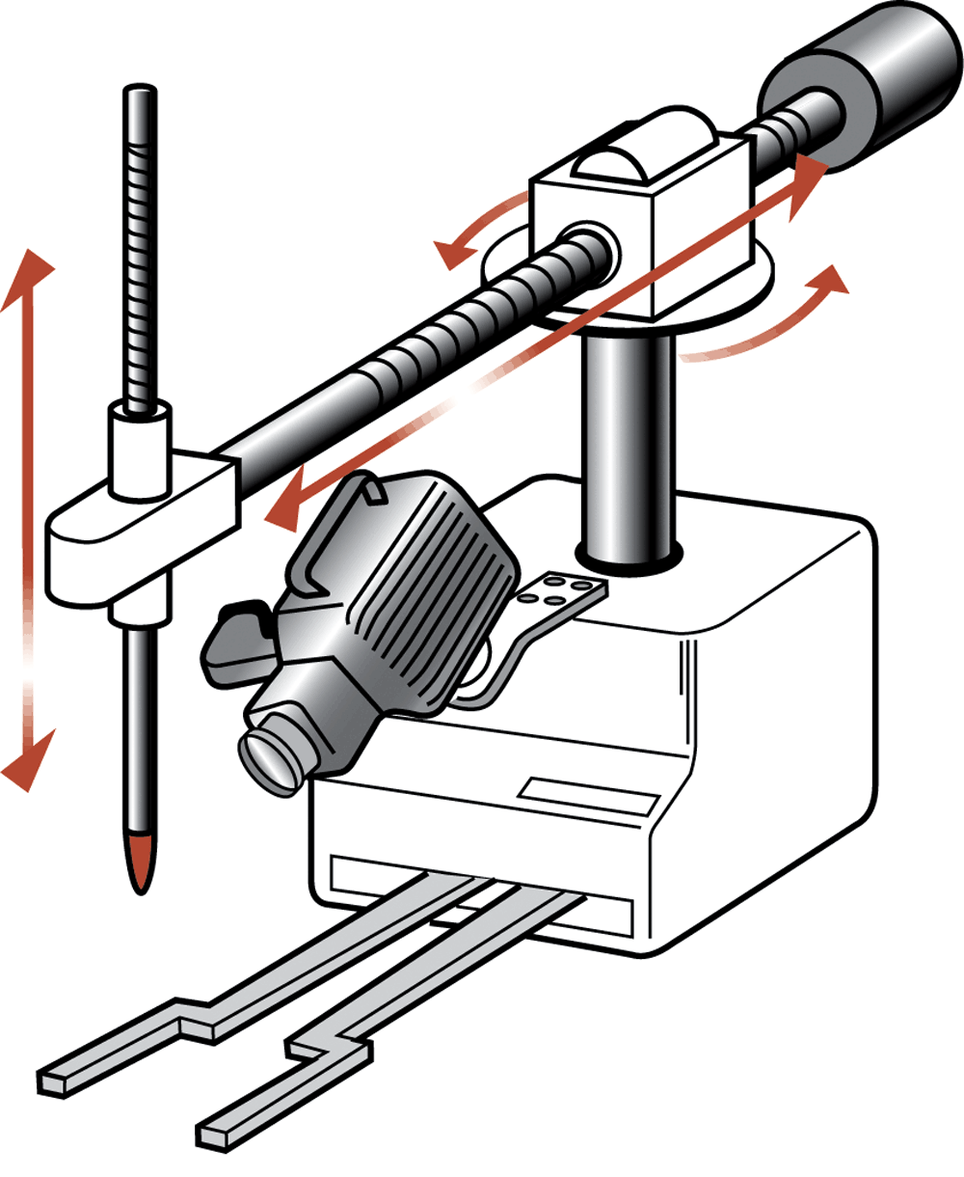
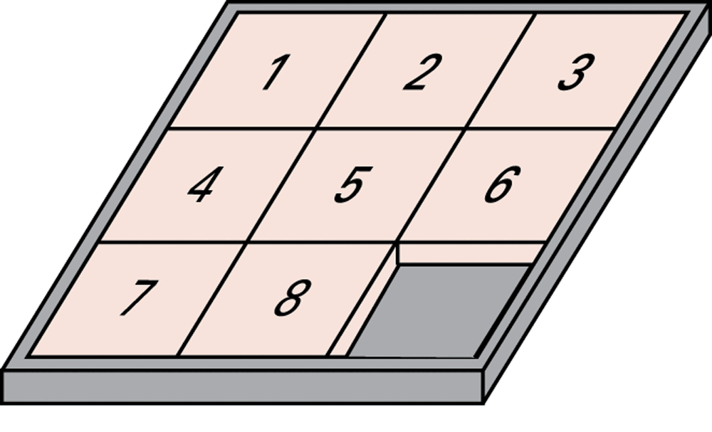
Applications of AI
(ROBOTS):
Puzzle Solving machine

Slide 34
Advantages of ROBOTS :
The most basic advantages which we are all aware of are:
ACCURACY SPEED
INCREASED PRODUCTIVITY
FLEXIBILITY

Slide 35
Advantages of ROBOTS :
Business Benefits:
Robots have the ability to consistently produce high-quality products and to precisely perform tasks
Since they never tire and can work nonstop without breaks, robots are able to produce more quality goods or execute commands quicker than their human counterparts

Slide 36
Advantages of ROBOTS :
Employee Benefits:
Robots can do the work that no one else wants to do—the mundane, dangerous, and repetitive jobs
Common Misconception about Robots:
Introducing robots into a work environment does not necessarily mean the elimination of jobs. With the addition of robots comes the need for highly-skilled, human workers

Slide 37
CONCLUSION
Every successful business must depend on real people for these abilities!!!

Slide 38
THANKS TO ALL OF YOU

